Slide 1

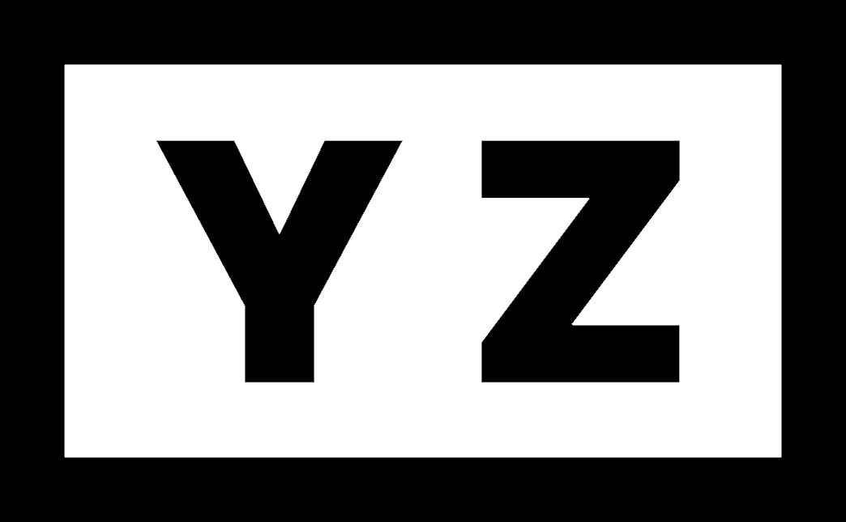
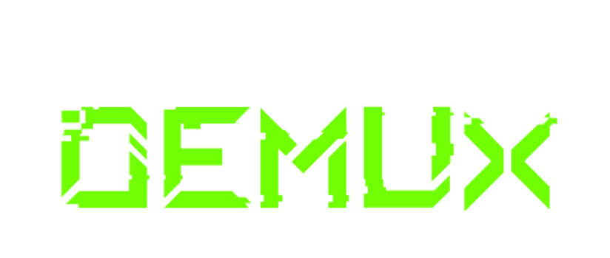
Technical Report
whiteboards and digital boards are often not
versatile or advanced enough to be used in modern educational, professional and creativity
settings.
Hakunamatata

Slide 2
TEAM DETAILS
Team Name: Hakunamatata
POINT OF CONTACT DETAILS
Name: Sravan Reddy
Mobile number: 8121358586
email: sravanreddychalla609@gmail.com

Slide 3
PS Code - SE PS 0
Introduction:-
🡪Background: Traditional whiteboards and digital boards are often not
versatile or advanced enough to be used in modern educational, professional and creativity
settings. The current tools either limit the users to mere basic drawing and writing functions or
they are too complicated with steep learning curves that make it impossible to be productive.
There is a need for a smart board solution that can meet both beginners and experts needs by
providing an extensible platform that can suit different complexities and user requirements
🡪Objectives and Key features: t will have two modes: Basic mode for simple tasks like sketching, drawing 2D objects,basic 3D objects with possibilities of adding images, videos and so forth and Advanced mode will take these features further by incorporating 3D board, map
integration, Q/A model, AI based tools as well as calculators hence making it suitable for
more complex tasks and professional usage scenarios

Slide 4
Tech Stack
🡪Tools and Technologies: React,FontAwesome,HTML5 Canvas API,Native Javascript Mouse Events,Google Maps.
🡪System Architecture:User Interaction : Users interact with the toolbar canvas through mouse events.
State Mangement: The selected tool and Drawing states are manged using React’s state management.
Rendering : Based on user input, the canvas API renders the corresponding graphics in real-time
Dynamic UI : The toolbar’s position is updated based on user actions, providing a flexible and customizable interface.

Slide 5
System Methodology
🡪Approach: Be usable across various sectors ranging from education, design and business
presentations etc., thus delivering a seamless experience for its users
- It will have two modes: Basic mode for simple tasks like sketching, drawing 2D objects,
basic 3D objects with possibilities of adding images, videos and so forth.
- Advanced mode will take these features further by incorporating 3D board, map
integration, Q/A model, AI based tools as well as calculators hence making it suitable for
more complex tasks and professional usage scenarios
Design Process: Set up the Enivornment
Create the basic structure
Implement the toolbar
handle Drawing Logic
Add Interactivity
Styling

Slide 6
System Methodology
🡪Implementation: Tool Buttons: Add tool buttons in the Toolbar component with icons from FontAwesome, aligning them in a column using CSS.Movable Toolbar: Implement drag-and-drop functionality using mouse events (onMouseDown, onMouseMove, onMouseUp) to allow the toolbar to be moved around the screen.
🡪TestingTest Functionality: Run the application and test all features, ensuring the drawing starts at the correct cursor position and the toolbar is fully movable.Fix Issues: Debug and fix any issues related to drawing accuracy, toolbar movement, and UI responsiveness.

Slide 7
Process Flowchart
Set Up Enivronment
Creating Workspace 2D and 3D
Creating Tool Bar
Add Interiactivity
&
Opitming and Debug

Slide 8
Possible Outcomes
🡪Expected Results: Schools and universities could adopt the SmartBoard as a standard tool in classrooms, leading to more interactive and effective teaching methods.
🡪Scalability: The scalability of your SmartBoard project is strong, as it can be easily expanded to support more features, users, and platforms. It can be adapted for larger educational institutions, creative industries, and even global markets with minimal adjustments. As demand grows, the project can handle increased usage and functionality without significant performance issues.
🡪Challenges: Performance, User Adoption, Compatibility ,Security Concerns, maintenance And updates

Slide 9









Business Model Canvas
s
Key partnerships
Key activities
Value proportions
Customer relationships
Customer segments
Website Development
&
Marketing
Consumers
Enterpises
Self Service
Website
&
Cloud Services
Developers
Key resources
Channels
Websites
Youtube Ads
User Base
Cost Structure
Revenue Streams
Licenses and Subscriptions
Website Development & Maintanence

Slide 10
Conclusion
🡪Impact and Future Implications: The SmartBoard project has the potential to greatly enhance collaboration, education, and creativity by providing a versatile virtual drawing board with advanced features. Its real-time collaboration capabilities make it valuable for remote teams and educators, while its interactive tools can engage students and creative professionals alike. The future could see integrations with other software, AI-driven features, and expanded cross-platform usability, making the SmartBoard even more versatile and accessible. Customization options and scalability will further enhance its application, making it a significant tool for various users and settings.
🡪Final Thoughts: Moving forward, I recommend focusing on user testing to refine the interface and enhance usability. Additionally, incorporating more advanced AI and integration features could further elevate the SmartBoard’s capabilities. Overall, the project has been a success in demonstrating the possibilities of virtual drawing tools and sets a strong foundation for future enhancements.

